Slide 1
Microsoft Graph API and PowerShell
Lee Ford
@lee_ford
Solution Architect
Symity Ltd

Slide 2
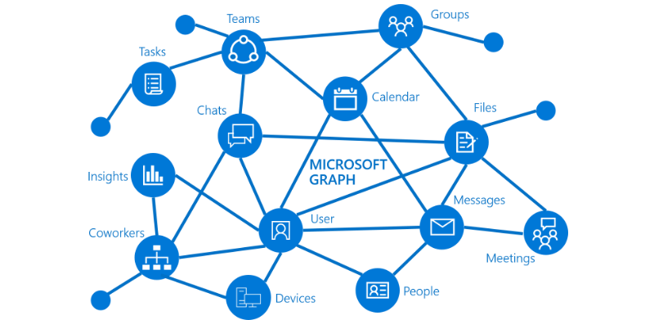
Microsoft Graph API
What is Graph API?
Graph API is Microsoft’s RESTful API for Microsoft 365 and Azure AD.
Using an Azure AD application (in almost any programming language you want), it allows you to interface directly with various Microsoft online services such as:
Exchange
OneDrive
SharePoint
Teams
Users and Groups
EMS

Slide 3
Using Graph API – High Level Steps
Create an Azure AD application. The application will also require the following to be set to be used with Graph API:
Permissions to be granted (user or application)
(Application permissions) Secret
(User permissions) Redirect URI
Authenticate with Azure AD using the application to obtain an OAuth token
With the OAuth token, make request to Graph API
Receive response from Graph API

Slide 4
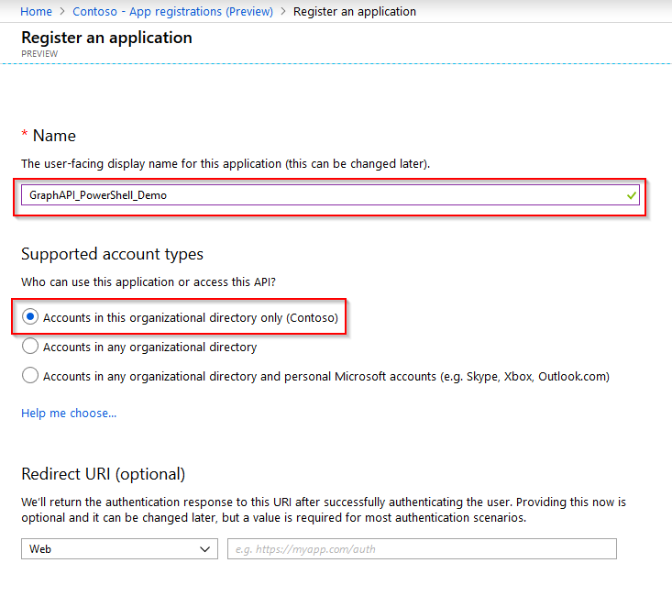
Create an AAD Application
You will need access to the Azure AD portal. Under “App Registrations (Preview)”, create a “New Registration”.

Slide 5
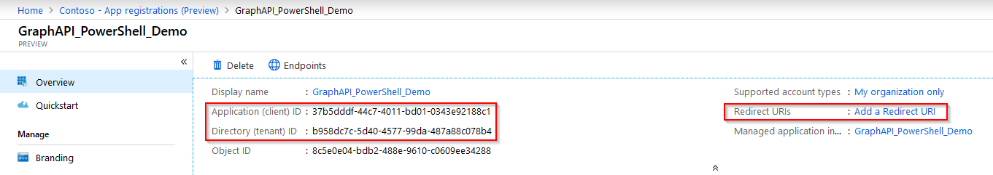
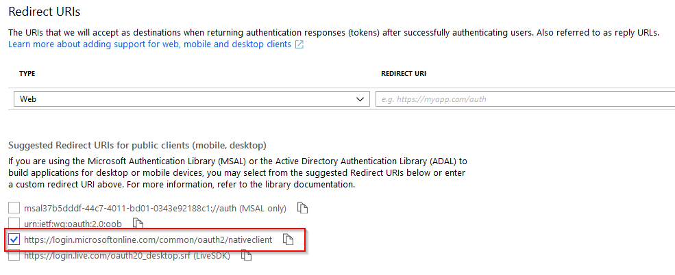
Create an AAD Application
With the application created, take note of the Application ID and Directory ID.
“Add a Redirect URIs” to add one. I’ve selected a pre-defined one, again keep note of it!

Slide 6
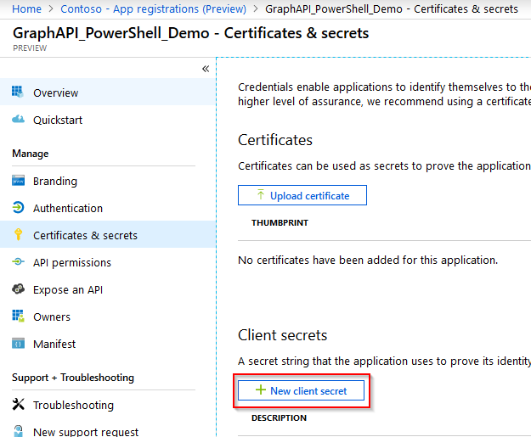
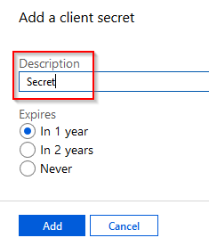
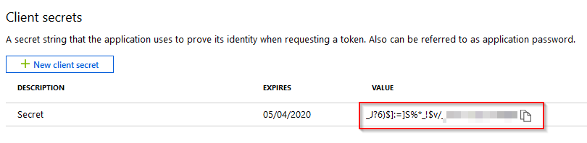
Create an AAD Application
Next step is to create a client secret. Keep this safe as you will only see it once!

Slide 7
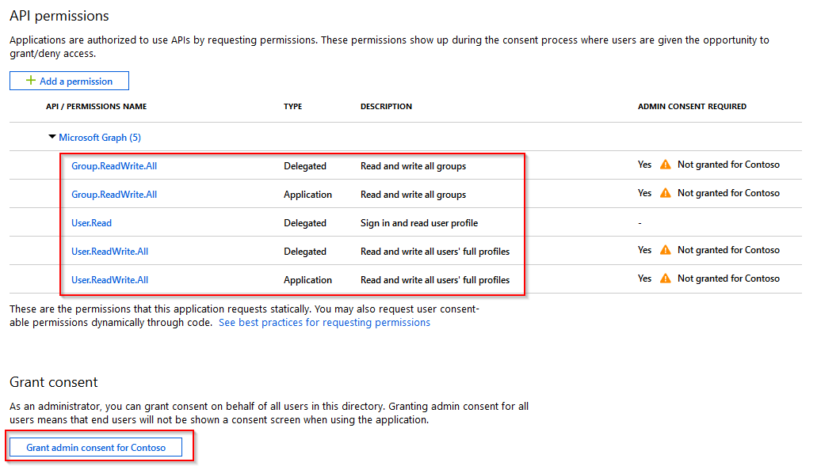
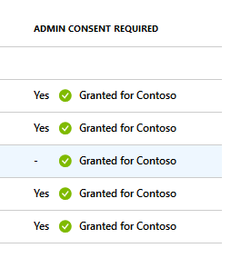
Create an AAD Application
The final step is assigning permissions (user or application) to the application.
I have assigned User and Group Read/Write permissions as an application and user (delegated).
Note: An admin needs to Grant these permissions to take effect.

Slide 8
Authentication with Azure AD
Before you can use Graph API, you will need to authenticate with Azure AD. Upon authentication with Azure AD, you will receive and OAuth token.
The token can then be used when making Graph API requests. The token can be used for 3600 seconds (1 hour), so a new token will need to be sought after that.
Based on what permissions you are using (Application or User), the method to obtain the token differs…

Slide 9
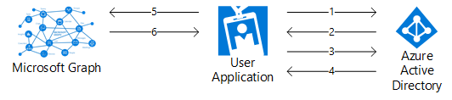
Obtain OAuth Token for User Permissions
Before you can use Graph API as a user, you need to authenticate with Azure AD as that user and obtain an OAuth token. The steps to do this are:
Direct user to https://login.microsoftonline.com and prompt to sign in (same login page as other services such as Office 365).
Once signed in, if permissions have been granted to the user for the Azure AD application, the application will be issued an authentication code in the response from the login page.
With the authentication code, a second request (without user input) is made to Azure AD to request an OAuth token.
If the request is successful, an OAuth token is issued to the application.
With the OAuth token attached, a request can now be made to Graph API.
Graph API will verify the token is valid, process the request and issue a response.

Slide 10
Obtain OAuth Token for User – PowerShell
# Add required assemblies (to bring up login page in WPF window)
Add-Type -AssemblyName System.Web, PresentationFramework, PresentationCore
# Application (client) ID, tenant ID and redirect URI of Azure AD application
$clientId = "<client id>"
$tenantId = "<tenant id>"
$redirectUri = “https://login.microsoftonline.com/common/oauth2/nativeclient”
# Scope - Needs to include all Azure AD User permissions required separated with a space
$scope = "User.ReadWrite.All Group.ReadWrite.All" # This is just an example set of permissions
# Random State - state is included in response, can be used to ensure state returned matches
$state = Get-Random
# Encode scope and Redirect URI to fit inside query string
$scopeEncoded = [System.Web.HttpUtility]::UrlEncode($scope)
$redirectUriEncoded = [System.Web.HttpUtility]::UrlEncode($redirectUri)
# Construct URI
$uri = "https://login.microsoftonline.com/$tenantId/oauth2/v2.0/authorize?client_id=$clientId&response_type=code&redirect_uri=$redirectUriEncoded&response_mode=query&scope=$scopeEncoded&state=$state"

Slide 11
Obtain OAuth Token for User – PowerShell (Cont.)
# Create Window for User Sign-In
$windowProperty = @{
Width = 500
Height = 700
}
$signInWindow = New-Object System.Windows.Window -Property $windowProperty
# Create WebBrowser for Window
$browserProperty = @{
Width = 480
Height = 680
}
$signInBrowser = New-Object System.Windows.Controls.WebBrowser -Property $browserProperty
# Navigate Browser to sign-in page
$signInBrowser.navigate($uri)
# Create a condition to check after each page load
$pageLoaded = {
# Once a URL contains "code=*", close the Window
if ($signInBrowser.Source -match "code=[^&]*") {
# With the form closed and complete with the code, parse the query string
$urlQueryString = [System.Uri]($signInBrowser.Source).Query
$script:urlQueryValues = [System.Web.HttpUtility]::ParseQueryString($urlQueryString)
$signInWindow.Close()
}
}

Slide 12
Obtain OAuth Token for User – PowerShell (Cont.)
# Add condition to document completed
$signInBrowser.Add_LoadCompleted($pageLoaded)
# Add WebBrowser to Window and Show Window
$signInWindow.AddChild($signInBrowser)
$signInWindow.ShowDialog()
# Extract code from query string
$authCode = $script:urlQueryValues.GetValues(($script:urlQueryValues.keys | Where-Object { $_ -eq "code" }))
if ($authCode) {
$uri = “https://login.microsoftonline.com/$tenantId/oauth2/v2.0/token”
# Construct Body
$body = @{
client_id = $clientId
scope = $scope
code = $authCode[0]
redirect_uri = $redirectUri
grant_type = "authorization_code"
}
# Get OAuth 2.0 Token
$tokenRequest = Invoke-WebRequest -Method Post -Uri $uri -ContentType "application/x-www-form-urlencoded" -Body $body
# Access Token
$token = ($tokenRequest.Content | ConvertFrom-Json).access_token
}

Slide 13
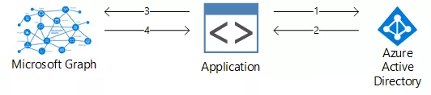
Obtain OAuth Token for Application Permissions
Before you can use Graph API with an application, you need to authenticate with Azure AD and obtain an OAuth token. The steps to do this are:
With the Azure AD application ID and secret, a request is made to Azure AD (https://login.microsoftonline.com/<tenantid>/oauth2/v2.0/token) to request an OAuth token.
If the request is successful, an OAuth token is issued to the application.
With the OAuth token attached, a request can now be made to Graph API.
Graph API will verify the token is valid, process the request and issue a response.

Slide 14
Obtain OAuth Token for Application – PowerShell
# Application (client) ID, tenant ID and secret
$clientId = "<client id>"
$tenantId = "<tenant id>"
$clientSecret = '<secret>'
# Construct URI
$uri = "https://login.microsoftonline.com/$tenantId/oauth2/v2.0/token"
# Construct Body
$body = @{
client_id = $clientId
scope = "https://graph.microsoft.com/.default"
client_secret = $clientSecret
grant_type = "client_credentials"
}
# Get OAuth 2.0 Token
$tokenRequest = Invoke-WebRequest -Method Post -Uri $uri -ContentType "application/x-www-form-urlencoded" -Body $body -UseBasicParsing
# Access Token
$token = ($tokenRequest.Content | ConvertFrom-Json).access_token

Slide 15
Using Graph API
How do you use Graph API?
With the issued OAuth token, you can make requests to Graph. These are in the form of HTTP requests:
Task | Method and URI
Get my profile | GET https://graph.microsoft.com/v1.0/me
Get all users in my organisation | GET https://graph.microsoft.com/v1.0/users
Get OneDrive status of a particular user | GET https://graph.microsoft.com/v1.0/users/<id-UPN>/drive
Create a new Team | POST https://graph.microsoft.com/v1.0/teams
Update an existing Team | PATCH https://graph.Microsoft.com/v1.0/teams/<id>

Slide 16
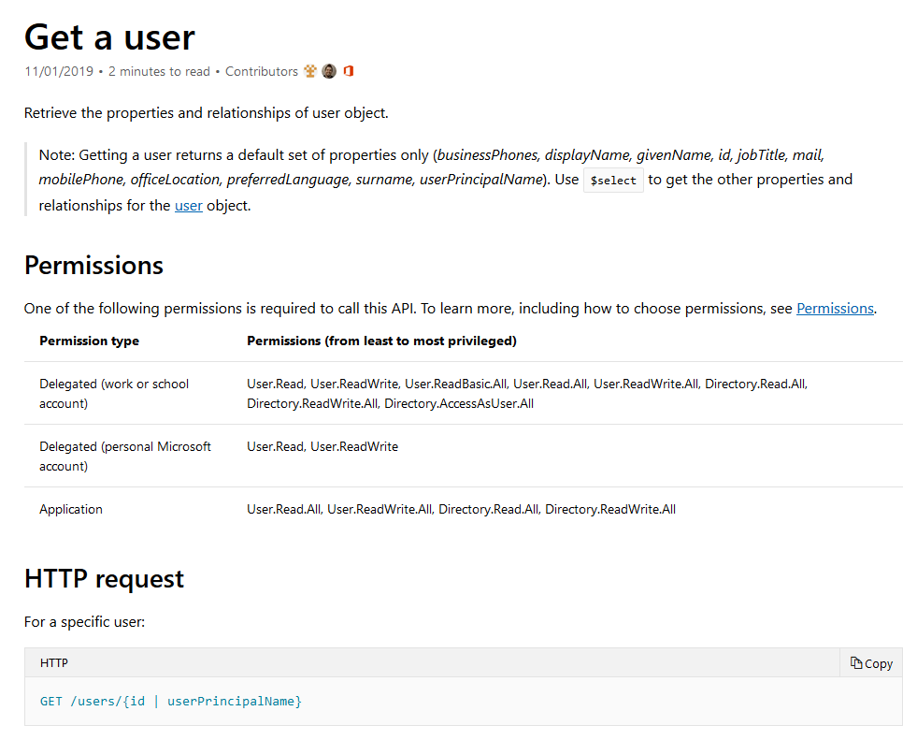
Using Graph API – Prepare
Before you can make an request, it is recommended to check the Graph API reference documentation to ensure you are submitting the request correctly.
This includes:
Permissions required
HTTP request (method and URL)
Request headers (in addition to token and content-type)
Request body (content) e.g. if creating a Team – name, description etc.

Slide 17
Using Graph API – Your First Request
Let’s start with a very basic request, retrieving your own user details.
Item | Value
Method | GET
URI | https://graph.microsoft.com/v1.0/me
Permissions (least to most) | User.Read, User.ReadWrite, User.ReadBasic.All, User.Read.All, User.ReadWrite.All, Directory.Read.All, Directory.ReadWrite.All, Directory.AccessAsUser.All
Request Headers | Header | Value
 | Authorization | Bearer {token}
 | Content-Type | application/json
Request Body | N/A

Slide 18
Using Graph API – Your First Request In PowerShell
For brevity, the token has already been acquired as $token. No additional body or headers needed in this request.
# Specify the URI, method, headers and content type
$uri = "https://graph.microsoft.com/v1.0/me"
$method = "GET"
$headers = @{"Authorization" = "Bearer $($token)" }
$contentType = "application/json"
# Run Graph API request
$response = Invoke-WebRequest -Method $method -Uri $uri -ContentType $contentType -Headers $headers -ErrorAction Stop
# Convert response from JSON to object
$content = $response | ConvertFrom-Json
Write-Host "`nYou are $($content.displayName), $($content.jobTitle)"

Slide 19
Using Graph API – Advanced Request
Building on the first request, let’s add a body to the request. This is a beta endpoint, so be warned, bugs may be present!
Item | Value
Method | POST
URI | https://graph.microsoft.com/beta/teams
Permissions | Group.ReadWrite.All
Request Headers | Header | Value
 | Authorization | Bearer {token}
 | Content-Type | application/json
Request Body (JSON) | { "template@odata.bind": "https://graph.microsoft.com/beta/teamsTemplates('standard')", "displayName": "My Sample Team", "description": "My Sample Team’s Description", "owners@odata.bind": [ "https://graph.microsoft.com/beta/users('userid')" ] }

Slide 20
Using Graph API – Advanced Request In PowerShell
# Specify the URI, method, headers and content type
$uri = "https://graph.microsoft.com/beta/teams"
$method = "POST"
$headers = @{"Authorization" = "Bearer $($token)" }
$contentType = "application/json"
# Create Body
$body = @{
'template@odata.bind' = "https://graph.microsoft.com/beta/teamsTemplates('standard')"
displayName = "Bham PSUG"
description = "A new team just for Bham PSUG"
'owners@odata.bind' = @(
"https://graph.microsoft.com/beta/users('778d779e-bcc8-431b-979a-e77c79f82123')"
)
}
# Convert body to JSON and un-escape
$bodyJson = $body | ConvertTo-Json -Depth 5 | ForEach-Object { [regex]::Unescape($_) }
# Run Graph API query
$response = Invoke-WebRequest -Method $method -Uri $uri -ContentType $contentType -Headers $headers -ErrorAction Stop -Body $bodyJson

Slide 21
Demo Time!

Slide 22
Tools To Help You
Graph Explorer – https://developer.microsoft.com/en-us/graph/graph-explorer - Microsoft web-based tool to allow you to interface with Graph API. Works really well, but user permissions only
Postman – https://www.getpostman.com/ - Tool used for interfacing with APIs
*Shameless Plug* MSGraphAPIGUI – https://github.com/leeford/MSGraphAPIGUI - A PowerShell GUI tool to interface with Graph API (similar to Graph Explorer, but supports application and user permissions)

Slide 23
Thank You For Listening!
Hope you found this useful and any feedback is welcome!
More information on this topic can be found on my blog:
https://www.lee-ford.co.uk/getting-started-with-microsoft-graph-with-powershell/
Code snippets can be found on my GitHub as ‘gists’: https://gist.github.com/leeford

